Slide 1

Managing Modern IT
Simplify IT Operations by Unifying Element Management
June 2013

Slide 2


















Vistara Corporate Overview
Who We Are
Our Customers
Incorporated July 2012
Headquarters in San Jose, CA
Development center in Hyderabad with 50 R&D engineers
Representative office in Japan
Used by managed service providers for seven years
Over 1100 customers using Vistara
Available for enterprise since January 2013
SaaS platform
Strong channel distribution – over 140 VARs through parent company alone
Available in North America and Japan
Patent pending technology
Our Distributors and VARs
Our Partners

Slide 3








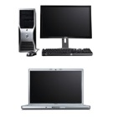
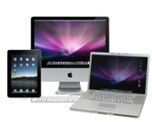

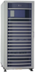
The Legacy
The reality is that most IT professionals have many kinds of infrastructure they must manage.
Physical Devices
Virtualized Servers
Private Cloud
Public Cloud
App
App
App
APP
VM
VM
App
App
App
App
App
App
Virtualization
VM
VM
VM
Virtualization
Switch
Router
Bring Your Own Device
Physical, virtual and cloud continue environments continue to expand
Notes:
You have all styles if IT infrastructure and applications to manage.

Slide 4
The Legacy
Desktops and Mobile Devices
Everyone is an administrator of something
Your data is… Anywhere
Even the best IT organizations wind up using multiple tools
Switch
Router
Bring Your Own Device
How Do You Define Success?
Notes:
You have all styles if IT infrastructure and applications to manage.

Slide 5
The problems with tools
One is great, two make a project
Integration
Patching
Report integration
There is no truth
Two applications cannot represent one result
Governance
Auditability
Role, Access matrix
You bought it and the shelf it lives on!

Slide 6

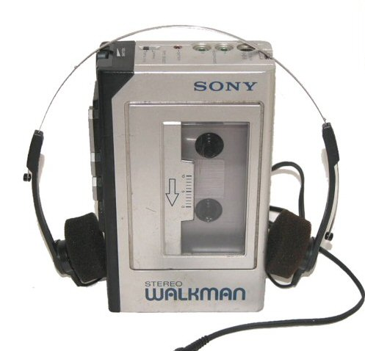




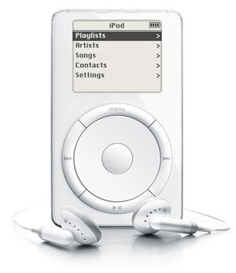
Evolve or Die
Sony created a market…
… Cloud Changes Everything
… Apple took it away…
Notes:
3+ decades ago in 1979 Sony launched the Walkman in Japan (1980 in the US). The world's first low-cost portable stereo, Walkman changed how and where we listened to music –culturally "hip”
1984 - available with comparable audio quality to the best professional audio equipment.
1989 - 50 million units had been shipped
1992 - 100 million units had been shipped
Late 1990s, the cassette-based Walkman was generally passed over in favor of CDs & other emerging technologies
After 2000, cassette-based Walkman products approached obsolescence as cassette format gradually phased out.
http://en.wikipedia.org/wiki/Walkman
http://www.techradar.com/news/audio/portable-audio/30-facts-from-30-years-of-the-sony-walkman-612817

Slide 7
Example: Pick any of the Big 4
Six products to manage the “Cloud”
Orchestration, Performance, ITSM, Network, Storage, Server management
Six modules for ITSM
Service Desk, Event, Change, Problem, Asset, and Billing
Most IT Operations and Service Management tools require that IT manage more than two dozen integrations native to the application environment.
Why work for them?

Slide 8
Unify Element Management
Think about what happens when you use one tool for ITSM and Infrastructure management
Service Delivery
Management
Monitoring
Automation
Metrics
Infrastructure Management

Slide 9

Unifying Hybrid IT Concerns
Hybrid Cloud is the delivery of integrated services from public and private cloud resources.
Challenges include
Identity Management
Security Models
Integrated Governance
Visibility
Metrics
Public Cloud
Private Cloud

Slide 10

Make the leap to unified IT management

Slide 11
Unified- What does it take?
API level integrations with Cisco UCS
API integration with NetApp FAS
API integration with EMC VNX, VNXe
API Integration with Brocade VDX
Ready integration with SCOM and Virtual Center
CI Discovery Templates
Provisioning, Scripting and Capacity Management
Correlation, Audit and Monitoring
Service Catalog for FlexPod and VSPEX
VSPEX®
FlexPod®
Notes:
FlexPod is the most efficient way to make a successful journey to your next generation data center.
FlexPod accelerates the transformation from infrastructure silos to a virtualized, shared environment with pre-validated, standardized, scalable building blocks that leverage a next-generation data center solution from Cisco, NetApp, and leading OS and hypervisor partners.
Unlike other solutions, FlexPod is a flexible platform—designed to fit many environments and handle mixed workloads. It can be easily tuned and optimized for your specific requirements. They are backed by easy-to-use tools that facilitate your design and sizing process—so you can add applications, and scale up and out as necessary
The solutions are integrated—so you can count on centralized and simplified management.
And the solutions are pre-validated—so they facilitate rapid, repeatable deployment.

Slide 12

Rules for Unifying Element Management
Centralize service delivery and save time and money
Reduce “Application Hopping”
Aggregate knowledge
Share your wisdom
Runbooks
Automation
Keep the tools you love
Save money by obsoleting shelfware and tools you don’t like
Pay for what you use
But don’t spend your time integrating other people’s software if you don’t have to!

Slide 13


The Benefits
Level 1 and Level 2 IT staff account for 80% of the reportable outcomes in IT!
Centralize operations activities onto one platform, and gain one source of truth.
Software upgrades itself
More secure
More scalable
Pay for what you use
Save 20% By Not Hopping

Slide 14
Why Vistara
Unifies service management and delivery across internal and externally sourced infrastructure and services
Unifies Element Management
Federate Hybrid IT
Manage Modern IT
IT Operations Cloud
Provides insight and measurement of IT spend and resources across the enterprise

Slide 20













Only Cloud Delivery is Cloudlike
Vistara
Alert Processing
VCare Servers
Vistara Servers
File Server
Database Server
DB
DB
Web Server
Router
Application
Server
Switch
Internet
FTP Server
VCare
Firewall
Active Directory
Public Cloud
VG
MS Exchange
Backup Server
App
App
App
App
App
App
VM
VM
VM
Enterprise IT
Virtualization
Private Cloud
Notes:
Make the point the Vistara is a SaaS Platform. It’s the logic is shared in the cloud- multi-multi tenant. That means

Slide 21

Let’s Get Started Today
Schedule a Demo!
Attend Our Next Webinars!
Email
sales@vistarait.com
Website
www.vistarait.com

